Slide 1
gRPC
Fundamentals
14º
Porto

Slide 2
Table of contents
01
02
03
04
gRPC What?
Why gRPC?
A bit of the history about RPC.
What is the reasoning behind gRPC?
Get it to Work
Pros & Cons
Hands-on it.
Nothing is perfect.
Technology is messy.

Slide 3
01
gRPC What?
Better to know the basics, huh?!

Slide 4
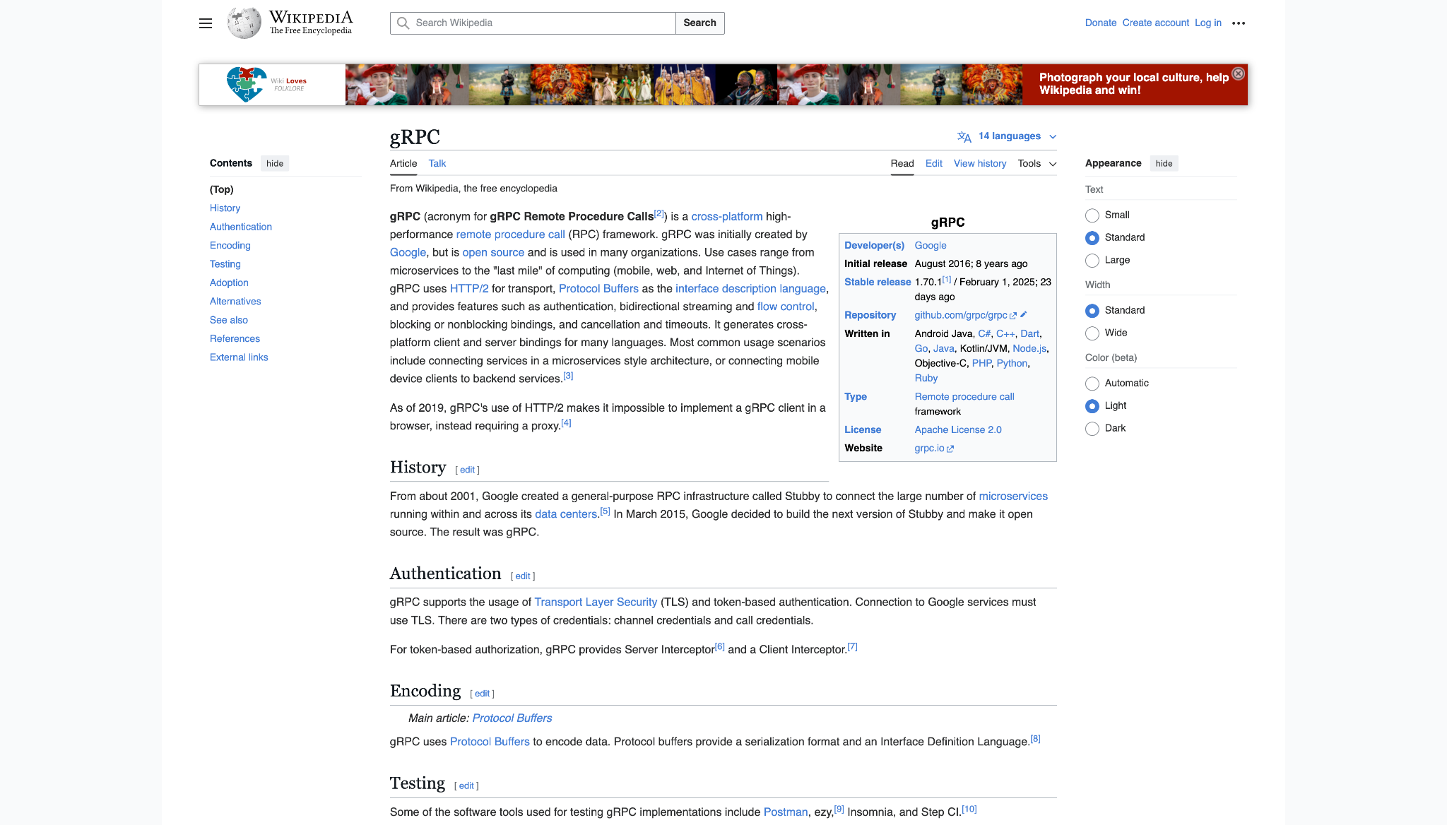

Slide 5
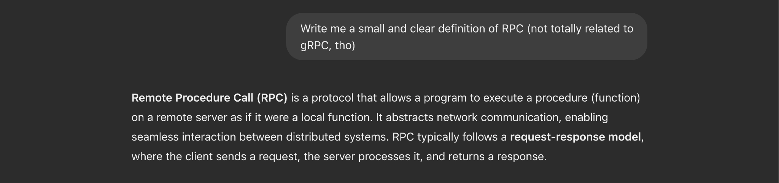

Slide 6
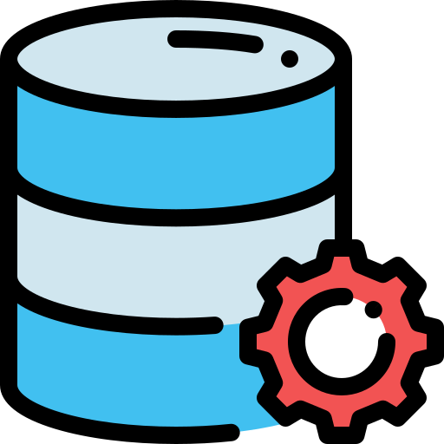
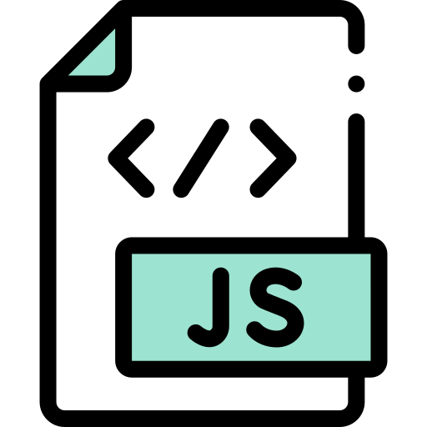

Normal Application Flow
Notes:
Let’s think if a normal application flow for a calculator application.

Slide 7
function main() {
const result = add(1, 2);
console.log(`The result is '${result}'`);
}
function add(a, b) {
return a + b;
}
// Run the application
main();

Slide 8
function main() {
const result = add(1, 2);
console.log(`The result is '${result}'`);
}
function add(a, b) {
return a + b;
}
// Run the application
main();
Implementation of this function is on another node

Slide 9


RPC Flow Example
Charge 20€ to credit card 1234
Success

Slide 10

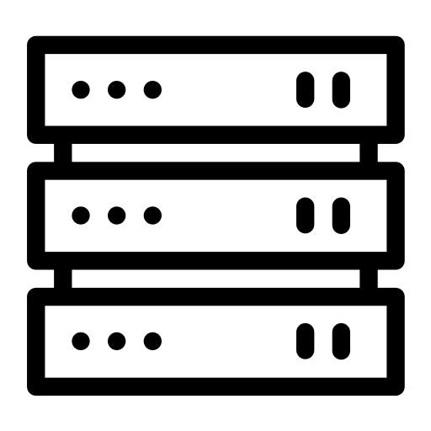
RPC Flow Example
RPC Client
RPC Server
processPayment() // stub
Marshal args
Unmarshal args
processPayment()
// implementation
waiting...
Marshal result
Function returns
Unmarshal result
Notes:
We have a e-commerce platform and we want to delegate the payment to a credit card to a 3rd party entity.

Slide 11
Location Transparency
Ideally, RPC makes a call to a remote function look the same as a local function call.

Slide 12
function main() {
const result = add(1, 2);
console.log(`The result is '${result}'`);
}
// Run the application
main(); // 3

Slide 13
RPC History
SunRPC / ONC RPC (1980s, basis for NFS)
COBRA: object-oriented middleware (1990s)
Microsoft DCOM (1996)
SOAP/XML-RPC: RPC using XML and HTTP (1998)
JAVA RMI (1999)
Thrift (Facebook, 2007)
Hermes (Spotify, early 2010s)
REST (1990s, widely adopted in the 2000s)
GraphQL (2015)
gRPC (Google, 2015)
Notes:
g DOES NOT stand for Google.

Slide 14
02
Why gRPC?
Isn’t REST good enough?!

Slide 15


Why gRPC?
Official support for multiple programming languages:
C++, Java, Python, Go, C#, Ruby, Node.js, Objective-C, PHP, Dart, Kotlin, Swift, Android, Java
Protobuf
HTTP2
Efficient Serialization;
Language-neutral;
Schema Definition Language
Multiplexing;
Bidirectional Streaming;
Server Push

Slide 16
Key Features
Bi-directional streaming;
Strongly-typed contracts;
Support for multiple platforms and environments;
Interceptors and middleware;
Support for various authentication mechanisms;
Code generation.
Notes:
Bi-directional streaming: Unlike traditional REST APIs, where requests and responses are one-way, gRPC supports bi-directional streaming. This means both the client and server can initiate multiple streams and send/receive data concurrently.
Strongly-typed contracts: gRPC uses Protocol Buffers to define the service contract (API) and data structures. This provides strong typing, meaning clients and servers can be more confident about the data they send and receive, and any mismatch or errors can be caught during compilation rather than at runtime.
Support for multiple platforms and environments: gRPC is suitable for a wide range of platforms, including mobile devices, browsers, IoT devices, and cloud-based services. It allows you to create consistent and efficient communication channels across different systems.
Interceptors and middleware: gRPC supports interceptors and middleware, which can be used to add custom logic at different points of the communication pipeline. Interceptors can handle authentication, logging, monitoring, and other cross-cutting concerns.
Support for various authentication mechanisms: gRPC supports different authentication methods, such as SSL/TLS for secure communication, API keys, and custom authentication mechanisms to ensure secure data transfer between clients and servers.
Code generation: gRPC provides tools to generate client and server code from the service definition in Protocol Buffers. This automation reduces the amount of boilerplate code needed, making development faster and less error-prone.
Error handling: gRPC has a rich set of status codes that allow clients and servers to communicate error conditions effectively, enabling better error handling and debugging.

Slide 17
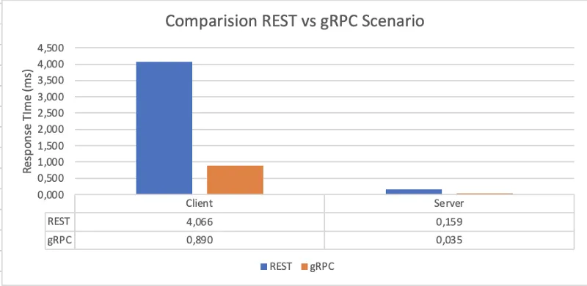
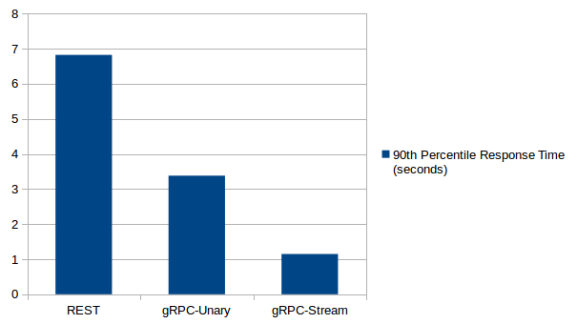
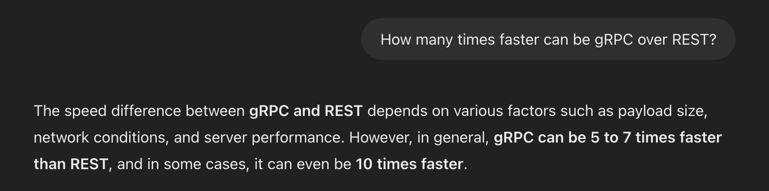
~70%
faster than traditional REST
Notes:
The greatest key feature is…

Slide 18
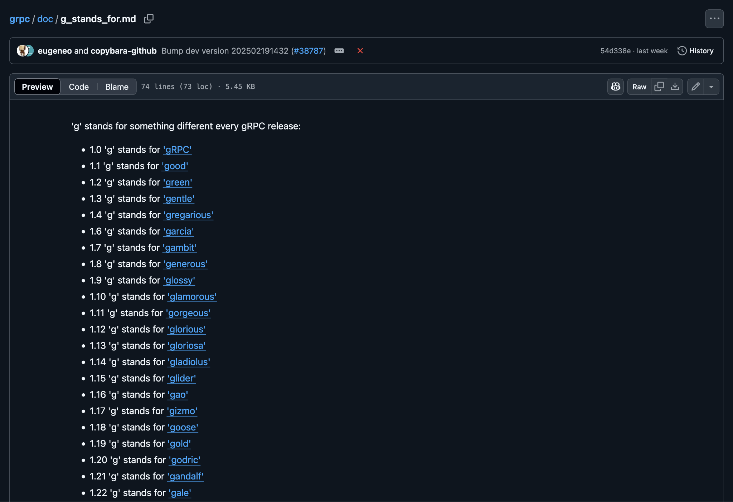

Slide 19
Where to start?
.proto file
Notes:
Bi-directional streaming: Unlike traditional REST APIs, where requests and responses are one-way, gRPC supports bi-directional streaming. This means both the client and server can initiate multiple streams and send/receive data concurrently.
Strongly-typed contracts: gRPC uses Protocol Buffers to define the service contract (API) and data structures. This provides strong typing, meaning clients and servers can be more confident about the data they send and receive, and any mismatch or errors can be caught during compilation rather than at runtime.
Support for multiple platforms and environments: gRPC is suitable for a wide range of platforms, including mobile devices, browsers, IoT devices, and cloud-based services. It allows you to create consistent and efficient communication channels across different systems.
Interceptors and middleware: gRPC supports interceptors and middleware, which can be used to add custom logic at different points of the communication pipeline. Interceptors can handle authentication, logging, monitoring, and other cross-cutting concerns.
Support for various authentication mechanisms: gRPC supports different authentication methods, such as SSL/TLS for secure communication, API keys, and custom authentication mechanisms to ensure secure data transfer between clients and servers.
Code generation: gRPC provides tools to generate client and server code from the service definition in Protocol Buffers. This automation reduces the amount of boilerplate code needed, making development faster and less error-prone.
Error handling: gRPC has a rich set of status codes that allow clients and servers to communicate error conditions effectively, enabling better error handling and debugging.

Slide 20
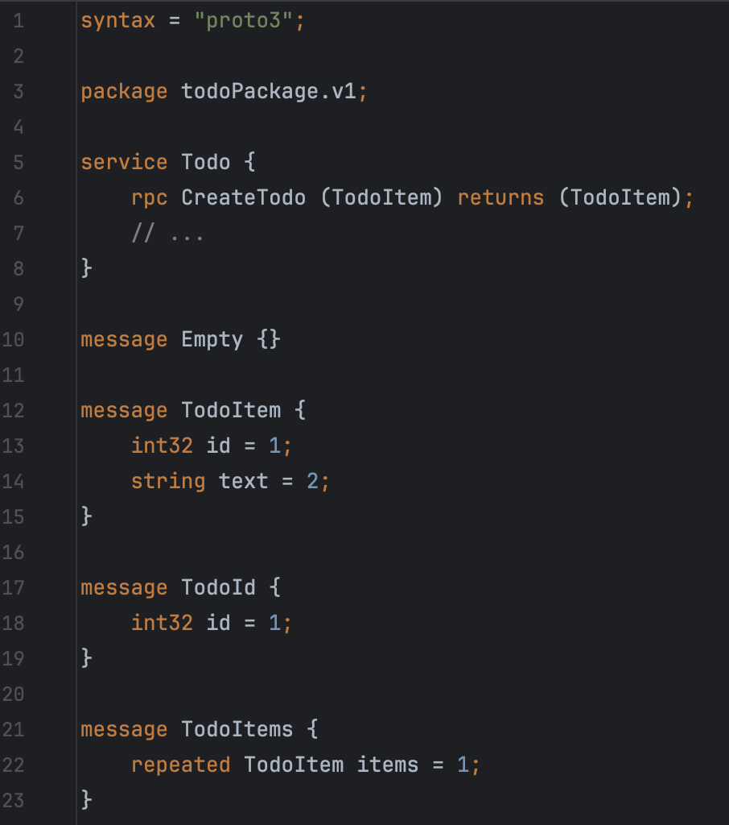
Syntax declaration
Namespace
Service definition,
with all possible RPCs
Messages definition
Notes:
Bi-directional streaming: Unlike traditional REST APIs, where requests and responses are one-way, gRPC supports bi-directional streaming. This means both the client and server can initiate multiple streams and send/receive data concurrently.
Strongly-typed contracts: gRPC uses Protocol Buffers to define the service contract (API) and data structures. This provides strong typing, meaning clients and servers can be more confident about the data they send and receive, and any mismatch or errors can be caught during compilation rather than at runtime.
Support for multiple platforms and environments: gRPC is suitable for a wide range of platforms, including mobile devices, browsers, IoT devices, and cloud-based services. It allows you to create consistent and efficient communication channels across different systems.
Interceptors and middleware: gRPC supports interceptors and middleware, which can be used to add custom logic at different points of the communication pipeline. Interceptors can handle authentication, logging, monitoring, and other cross-cutting concerns.
Support for various authentication mechanisms: gRPC supports different authentication methods, such as SSL/TLS for secure communication, API keys, and custom authentication mechanisms to ensure secure data transfer between clients and servers.
Code generation: gRPC provides tools to generate client and server code from the service definition in Protocol Buffers. This automation reduces the amount of boilerplate code needed, making development faster and less error-prone.
Error handling: gRPC has a rich set of status codes that allow clients and servers to communicate error conditions effectively, enabling better error handling and debugging.

Slide 21

Show me the code, human!

Slide 22

04
Pros & Cons

Slide 23


Pros
Compact
Fast
One Client Library
Progress Feedback (eg, upload)
H2/Protobuf
Strongly Typed Contracts
Built-in Authentication and Security
Cons
Code Generation
Error Handling
Versioning
Compression Overhead
No native browser support
Notes:
Code Generation: gRPC generates code from protobuf definitions, which can make debugging and maintaining the code more challenging. Any changes to the API contract may require regenerating the code and updating dependent systems.
Error Handling: gRPC relies heavily on HTTP/2, and some older proxies and load balancers may not fully support it. Handling errors in gRPC calls can be more complicated and require additional configuration in certain environments.
Versioning: Managing API versioning can be more complex in gRPC compared to REST APIs because gRPC uses protocol buffers. Any changes to the API require careful handling to maintain backward compatibility, and multiple versions may need to coexist.
Compression Overhead: While gRPC provides support for data compression, it can add overhead in terms of CPU usage. The compression/decompression process can impact performance, especially on resource-constrained devices.
Documentation and Learning Resources: Compared to more established technologies like REST, the availability of comprehensive documentation and learning resources for gRPC might be relatively limited, making it harder for newcomers to get up to speed.

Slide 24
Thanks!
Does anyone have any questions?

